Slide 1


DEBRINET
S.S.J.D.D.
Small Space Junk Disposal Device

Slide 2
THE VISION
We aim to protect space through an innovative, nature-inspired solution that tackles the growing threat of orbital debris.
Our concept: a flexible “space blanket” made from Dyneema and Kevlar, designed to collect and secure debris of various sizes in orbit.
This intelligent net can deploy autonomously, capture debris, and prepare it for controlled deorbiting or recycling.
By combining aerospace technology with sustainability, we offer a scalable solution to combat space pollution.
Our mission is to promote a safe, clean, and sustainable orbital environment, ensuring the future of space exploration for generations to come.

Slide 3
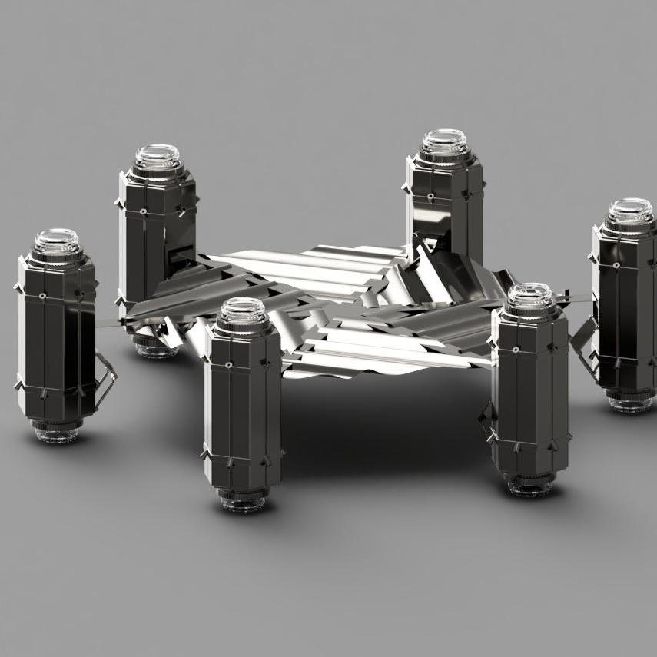
Description
Our product’s primary goal is the removal of space debris, such as fragments from destroyed satellites, non-functional satellites, and satellites that have exceeded their operational lifespan.
The net is made of three layers: Dyneema for strength, EVA foam for flexibility, and Kevlar for impact resistance. This combination makes the net lightweight but very durable in the harsh conditions of space.This net serves as the primary tool for redirecting debris toward destruction, gradually approaching target objects and slowly guiding them into Earth’s atmosphere.
To control the net, we designed it with six thrusters placed around the hexagon. These thrusters allow the system to keep its orientation stable and adjust its path while approaching debris targets.
The satellite uses cameras and sensors (LiDAR) to identify debris and navigate safely, relying on orbital data (TLEs from sources like Space-Track, NASA, and ESA) to avoid collisions with active satellites.
Render of our product

Slide 4


BENEFITS
1. Supports Scientific Research and Space Exploration A safer orbital environment allows scientific missions to operate longer and with fewer risks, opening new opportunities for innovation and discovery.
2. Creates New Economic Opportunities Reducing space debris fosters the growth of new industries focused on space maintenance, recycling, and sustainable exploration.
3. Reduces the Risk of Space Collisions Over 100 million uncontrolled objects orbit Earth today. Capturing debris helps prevent damage to active satellites, space stations, and crewed missions.

Slide 5



IMPACT
4. Protects Communication and GPS Infrastructure Cleaner orbits ensure the reliability of global communication, navigation, and data networks that depend on satellite systems.
5. Prevents the Kessler Syndrome This theory warns that debris collisions could trigger a chain reaction, making Earth’s orbit unusable for decades. Acting now helps prevent irreversible orbital pollution.
6. Enables Future Recycling Opportunities Captured debris could be analyzed, reused, or recycled in orbital factories, turning waste into valuable resources.
7. Lowers the Cost of Orbital Accidents Repairing or replacing damaged satellites costs hundreds of millions of dollars — prevention is far cheaper and more sustainable.

Slide 6

BUSINESS IDEA
Our initiative proposes an innovative solution to reduce the risks caused by space debris through the development of an advanced orbital capture system — a flexible “blanket” made from ultra-resistant materials such as Dyneema.
The system is designed to capture debris of various sizes and shapes, ensuring safety, adaptability, and durability in the extreme conditions of outer space.
Development will take place in a specialized technology center equipped for testing, simulation, and prototype assembly, focused on maximizing system efficiency and reliability.

Slide 7
Target Market Overview
National Space Agencies (NASA, ESA, JAXA, ISRO)
Active in LEO (ISS, research satellites)
Responsible for orbital sustainability regulations
Already funding debris removal projects (ESA ClearSpace-1)
Needs: Direct contracts for orbital cleaning prototypes
Motivation: Protect investments & maintain global leadership
Major Commercial Constellation Operators (SpaceX, Amazon Kuiper)
Thousands of satellites in LEO → high collision risk
Single collision could destroy satellites worth tens of millions
Needs: “Debris removal as a service” or deorbiting contracts
Motivation: Protect assets & ensure uninterrupted services

